Slide 1

Project: Titanic
Link: https://www.kaggle.com/c/titanic/data
Dataset: Titanic.csv
Presenting by Jeevan Raj

Slide 2
Below is a brief information about each columns of the dataset
Passenger: An unique index for passenger rows. It starts from 1 for the first row and increments by 1 for every new row.
Survived: This shows if the passenger survived or not. 1 stand for survived and 0 stands for not survived.
Pclass: Ticket class. 1 stands for First class ticket. 2 stands for Second class ticket. 3 stands for Third class ticket.
Name: Passenger's name. The name also contains a title. “Mr.” for man. “Mrs.” for a woman. “Miss” for a girl. “Master” for the boy.
Sex: Passenger's sex. It's either Male or Female.

Slide 3
Below is a brief information about each columns of the dataset
8. Parch: Number of parents of children travelling with each passenger.
9. Ticket: Ticket number.
10. Fare: How much money the passenger has paid for the travel journey.
11. Cabin: Cabin number of the passenger. "NaN" values in this column indicates that the cabin number of that particular passenger has not been recorded.
12. Embarked: Port from where the particular passenger was embarked/boarded.

Slide 4
Challenges in the Project/Data
Some of the features were having missing values [Handling the missing values]
Age, Cabin, Embarked having a missing values
All the data were not having numeric datatype [converting the object dtypes to numeric where machine learning can understand]
Some of the data was not Straight forward

Slide 5
Major Findings through EDA
Women from 1st and 2nd Pclass have almost 100% survival chance.
Men from 2nd and 3rd Pclass have only around 10% survival chance.
Almost all females from Pclass 1 and 2 survived.
Females dying were mostly from 3rd Pclass.
Males from Pclass 1 only have slightly higher survival chance than Pclass 2 and 3.
1st Pclass has very few children as compared to other two classes.
1st Plcass has more old people as compared to other two classes.

Slide 6
Almost all children (between age 0 to 10) of 2nd Pclass survived.
Most children of 3rd Pclass survived.
Younger people of 1st Pclass survived as compared to its older people.
Most male children (between age 0 to 14) survived.
Females with age between 18 to 40 have better survival chance
This shows that there are duplicate Ticket number and Cabins shared this information got by seing freq row. The highest number of duplicate ticket number is "CA. 2343". It has been repeated 7 times. Similarly, the highest number of people using the same cabin is 4. They are using cabin number "C23 C25 C27".
We also see that 644 people were embarked from port "S".
Among 891 rows, 577 were Male and the rest were Female.

Slide 7
My Learning
I Learnt how to handle the missing values
I Learnt hot to convert object datatype to int by doing some modifications
Learnt how to find the insights from the data by visualizing the plots
Learnt how to Perform Feature Extraction
Learnt how to Perform OneHotEncoding
Learnt how to Build Model by using different Classification Algorithms

Slide 8
Data Manipulation
Replacing some less common titles with the name "Other".
Convert the categorical Title values into numeric form
Replacing null values with mode
converting the categorical value of Sex into numeric. We represent 0 as female and 1 as male
Categorizing age into 5 different age ranges.
Create FareBand and divided the Fare into 4 category ranges.

Slide 9
Model
Logistic Regression
Support Vector Machines (SVC)
Linear SVC
k-Nearest Neighbor (KNN)
Decision Tree
Random Forest
Naive Bayes (GaussianNB)
Perceptron
Stochastic Gradient Descent (SGD)

Slide 10
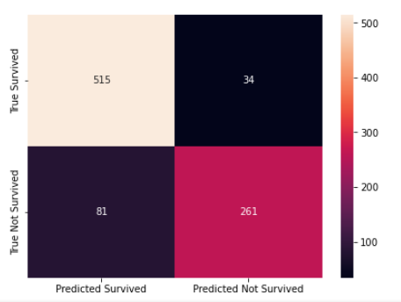
Building Model
Here I have Built the model using different algorithms as shown in the above slide
I am considering Random Forest Classifier because it is giving me the highest accuracy when compared to another model to perform Confusion Matrix
You can see my confusion Matrix Out of 549 it predicted True Survived
515 times correctly and 34 times
wrongly predicted where for not
Survived
Out of 342,261 times it predicted
Correctly and 81 times it predicted
wrongly

Slide 11
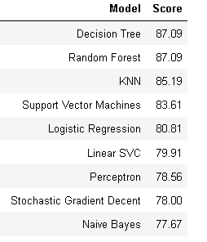
Comparison of Models
By seeing the table, we can say that Decision Tree and Random Forest classifiers have the highest accuracy score.
Among these two, we choose the Random Forest classifier as it has the ability to limit overfitting as compared to the Decision Tree classifier.

Slide 12


